Slide 1
Updates on Adenotonsillar Diseases.
DR. REUEL KAGENI MAINA
17/10/2025

Slide 2
Outline
Introduction
Epidemiology
Pathophysiology
Clinical features
Investigations
Treatment

Slide 3
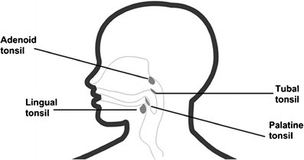
Introduction
Spectrum of diseases - 61.2%¹
Waldeyers ring
Management – medical or surgical
Adenotonsillectomy - common

Slide 4
Epidemiology
Peak 2-4 yrs – small volume of nasopharynx
Larger at 7yrs
Regresses at 15yrs
Male:female 1:1
Approx 600,000 adenotonsillectomies performed/ year²

Slide 5
Pathophysiology
Lymphoid tissue covered by respiratory epithelium
Play a role in immunity
Group A B hemolytic streptococcus
Increase in IgA ,post op decreases

Slide 6

Clinical features – Adenoid hypertrophy
Nasal blockage
Snoring
Mouth breathing
Sleep apnoea – restless sleep, waking frequently, unusual position

Slide 7
Clinical features - Tonsillitis
Recurrent throat infections – fever, tonsillar exudate, lymphadenopathy
Paradise criteria – 7 or more in 1 year, 5 or more in 2 yrs, 3 or more in 3 years
OSA
Peritonsillar abscess
Febrile convulsions
Halitosis
Infectious mononucleosis
OME
Neoplasms

Slide 8
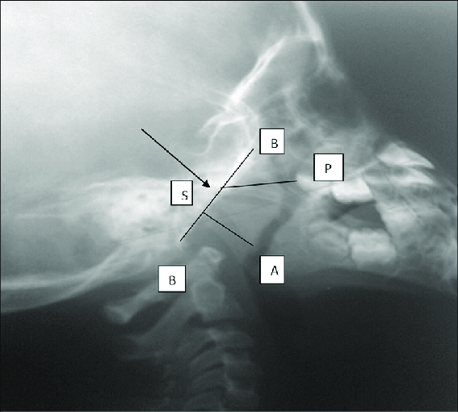
Investigations
Post nasal space x-ray

Slide 9
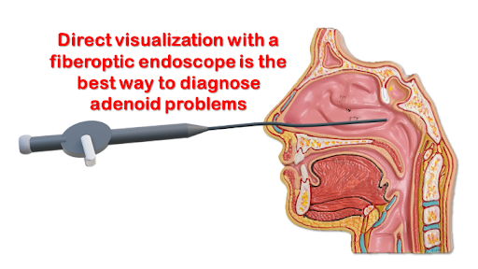
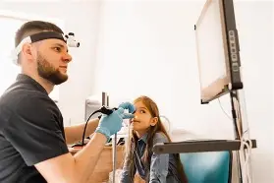
Investigations
Flexible nasoendoscope

Slide 10
Investigations
Laboratory
FHG
UECs

Slide 11
Treatment
Watchful waiting
Medical
Surgical

Slide 12
Medical
Adenoid disease
Triple therapy – steroid nasal spray /steroid nasal drops , antihistamine , leukotriene receptor antagonist
Tonsillar disease
Analgesics
Hydration
Antibiotics – If fever persists for more than 24 – 48 hrs – first line amoxicillin

Slide 13
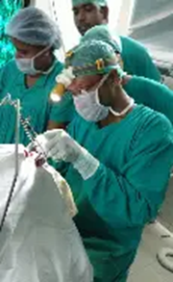
Surgical
Cold steel
Diathermy
Coblator
Laser

Slide 14
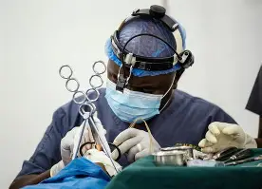
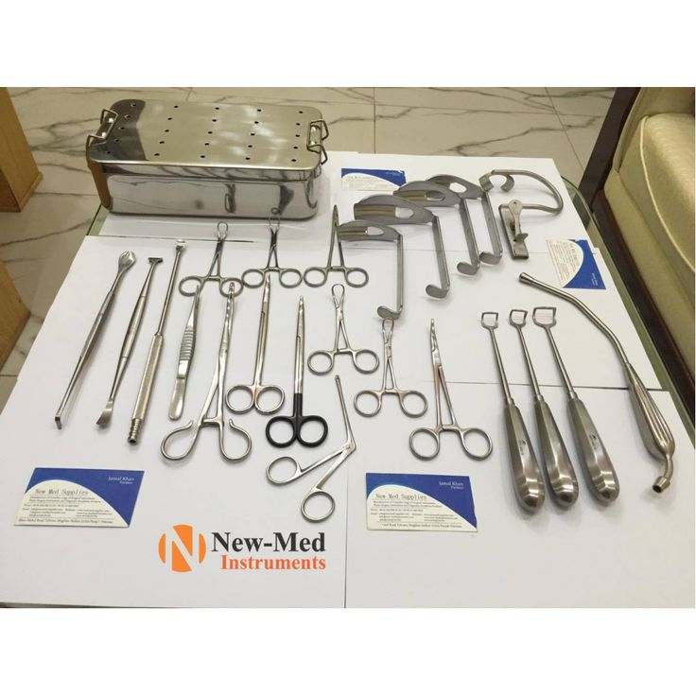
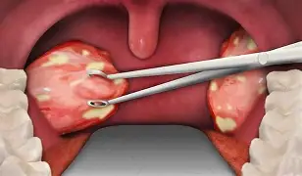

Slide 15
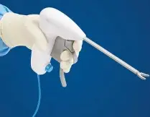
Bizact

Slide 16

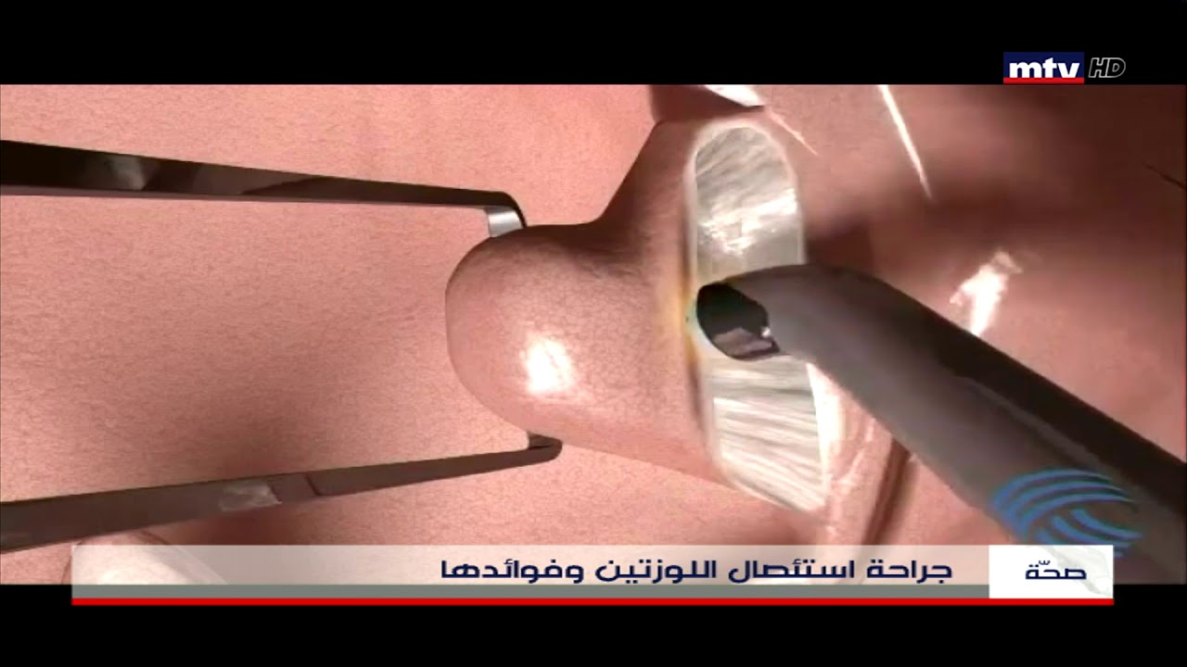
Coblator adenotonsillectomy

Slide 17
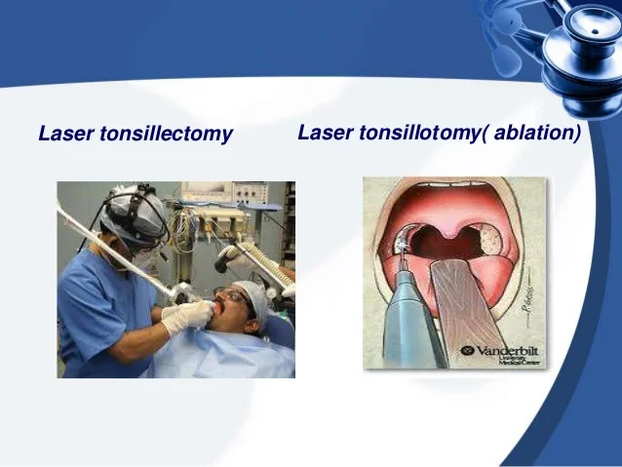
Laser adenotonsillectomy

Slide 18
Thank you

