Slide 1


Atsiaya Sammy | Product Manager

Slide 2


Contest
KENTS 2025

Slide 3

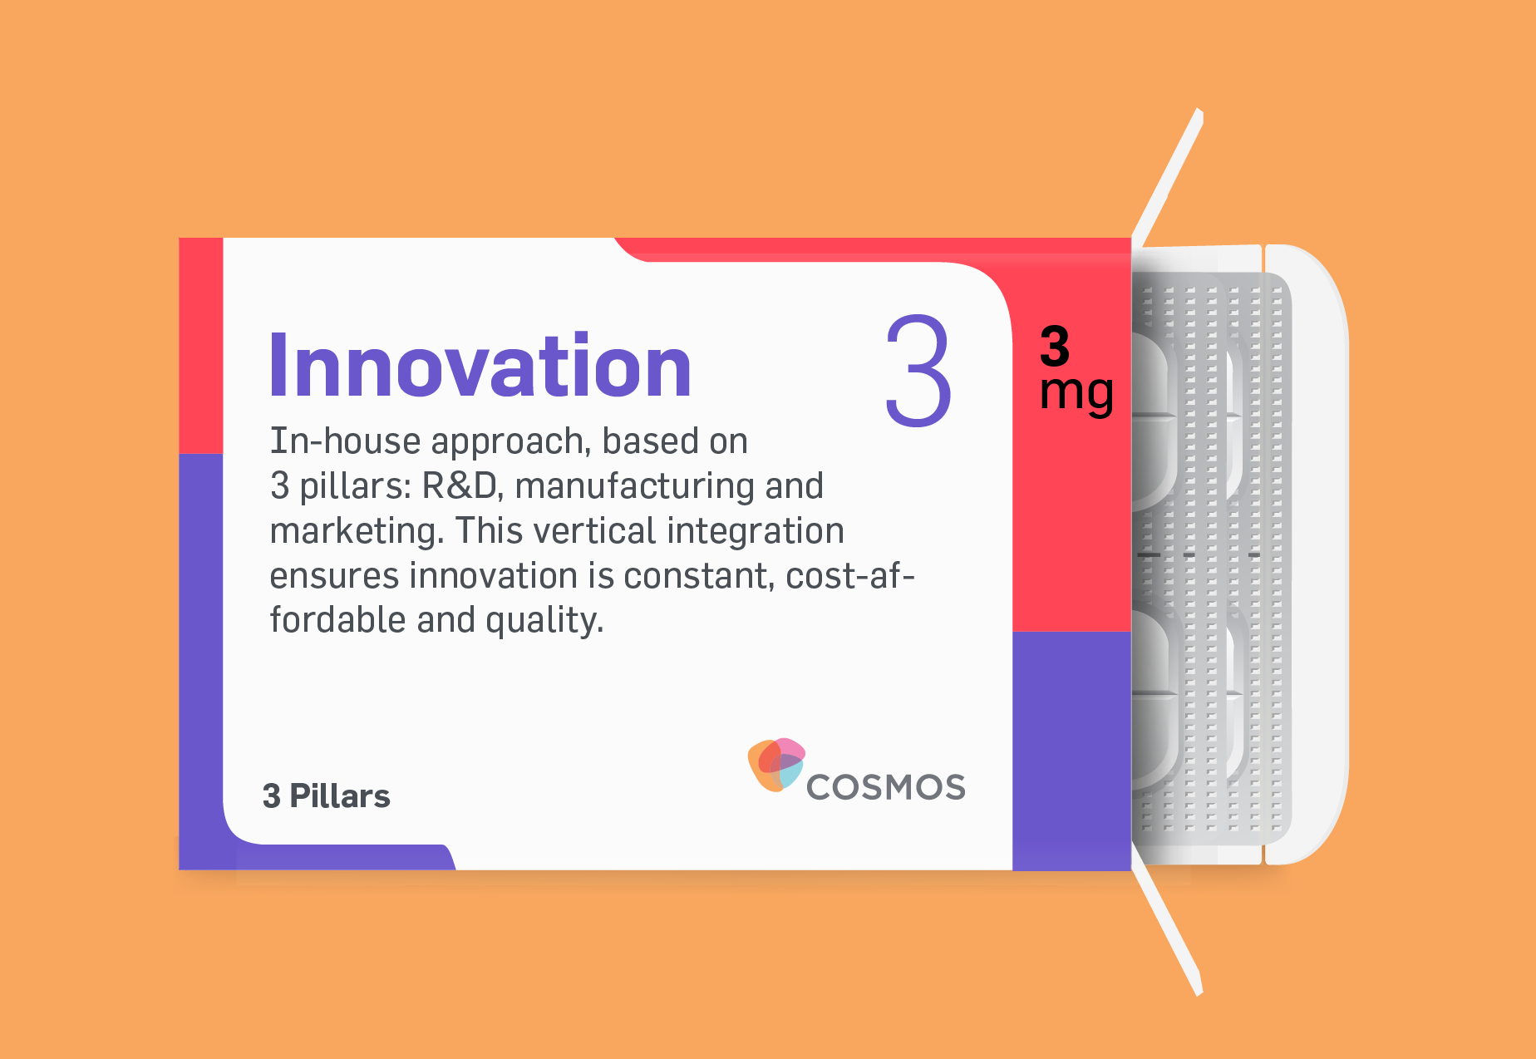
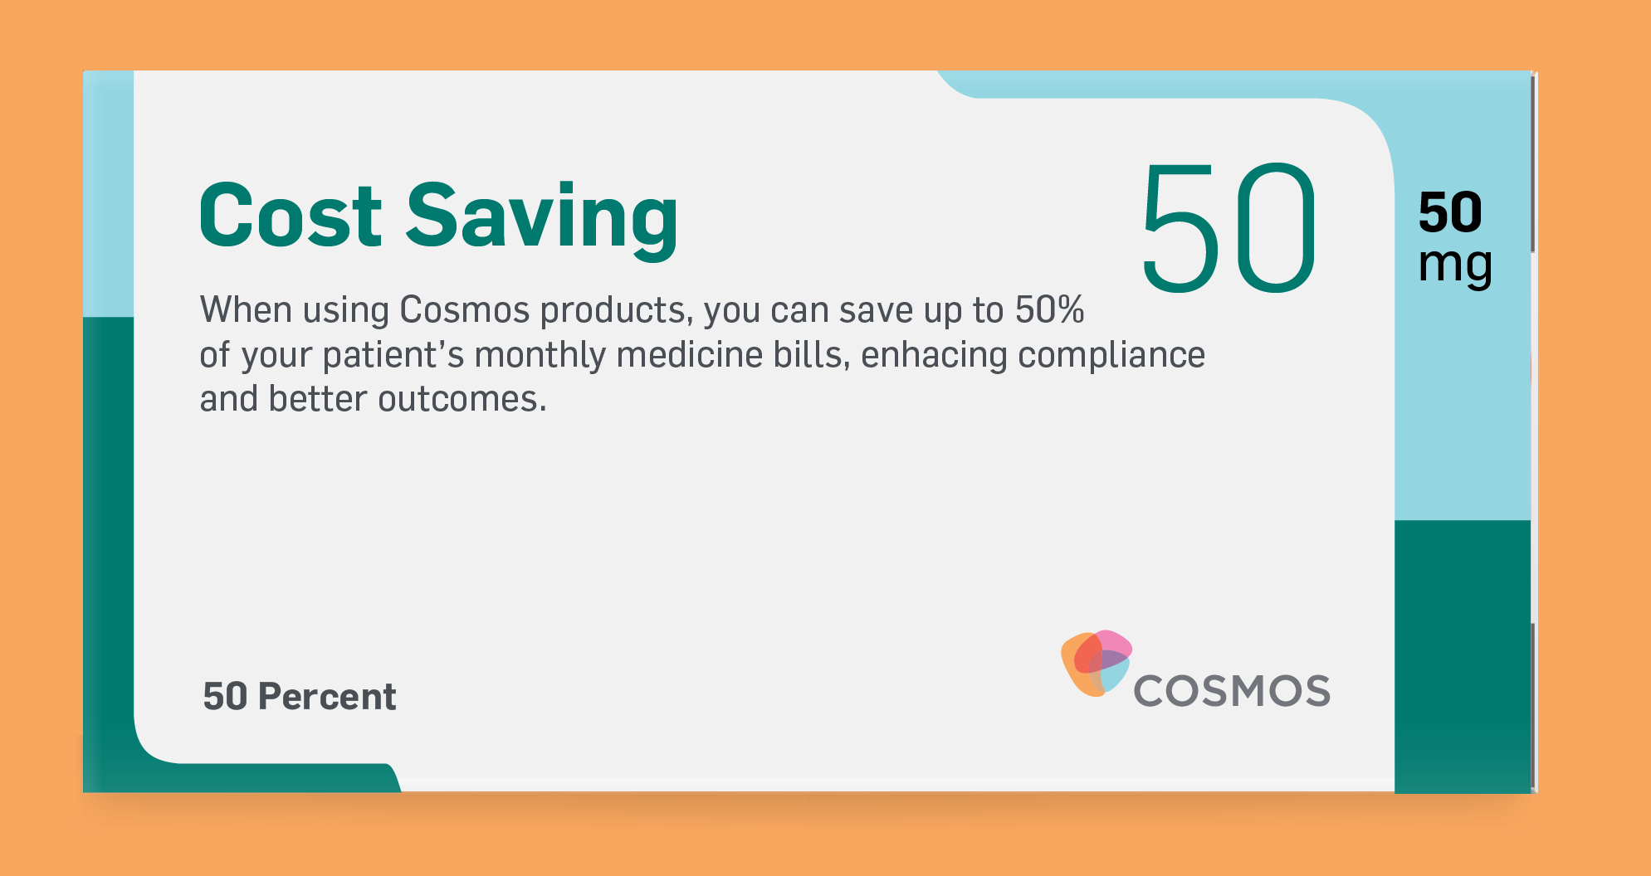

Slide 4


Slide 5
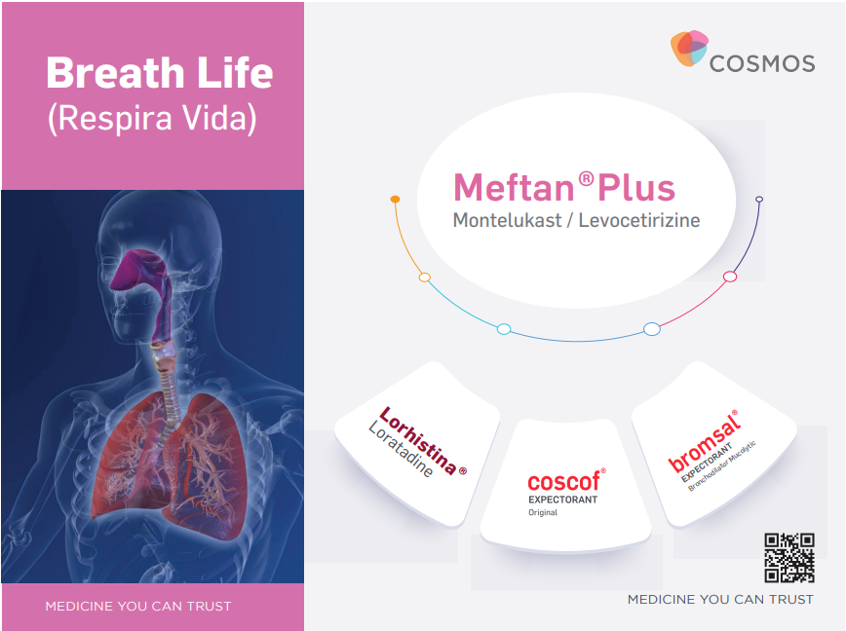

Slide 6
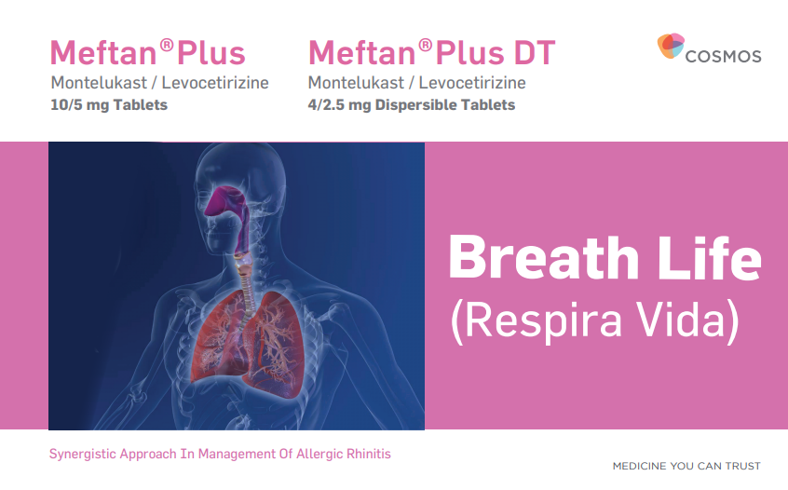

Slide 7
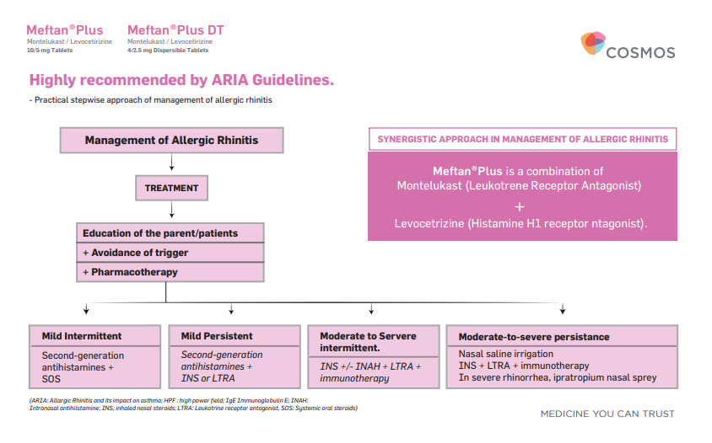

Highly recommended by ARIA Guidelines.
- Practical stepwise approach of management of allergic rhinitis
Management of Allergic Rhinitis
SYNERGISTIC APPROACH IN MANAGEMENT OF ALLERGIC RHINITIS
Meftan®Plus is a combination of Montelukast (Leukotrene Receptor Antagonist)
+
Levocetrizine (Histamine H1 receptor antagonist).
TREATMENT
Meftan Plus/DT
Education of the parent/patients
+ Avoidance of trigger
+ Pharmacotherapy
Mild Intermittent
Mild Persistent
Moderate to Servere intermittent.
Moderate-to-severe persistance
Second-generation antihistamines + SOS
Second-generation antihistamines + INS or LTRA
Nasal saline irrigation
INS + LTRA + immunotherapy
In severe rhinorrhea, ipratropium nasal spray
INS +/- INAH + LTRA +
immunotherapy
(ARIA: Allargic Rhinitis and its impact on asthma; HPF : high power field; IgE Immunoglobulin E; INAH:
Intranasal antihilstamine; INS: inhaled nasal steroids; LTRA: Leukotrine receptor antagonist, SOS: Systemic oral steroids)
Meftan®Plus

Slide 8
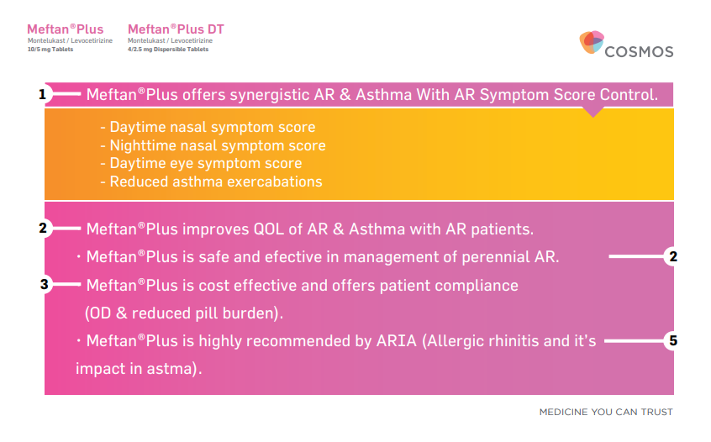

Slide 9
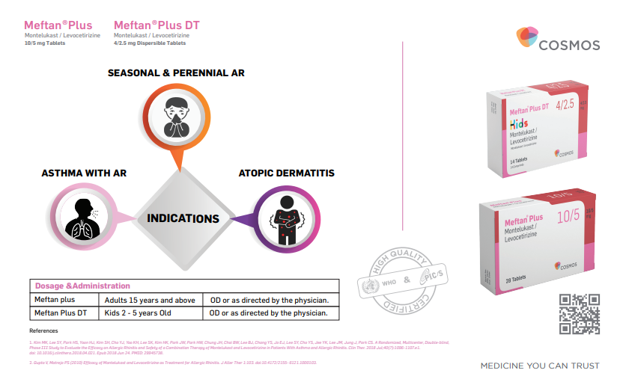

Slide 10
What is the significance of Meftan Plus/
Meftan Plus DT in Asthma with Allergic Rhinitis management?

Slide 11
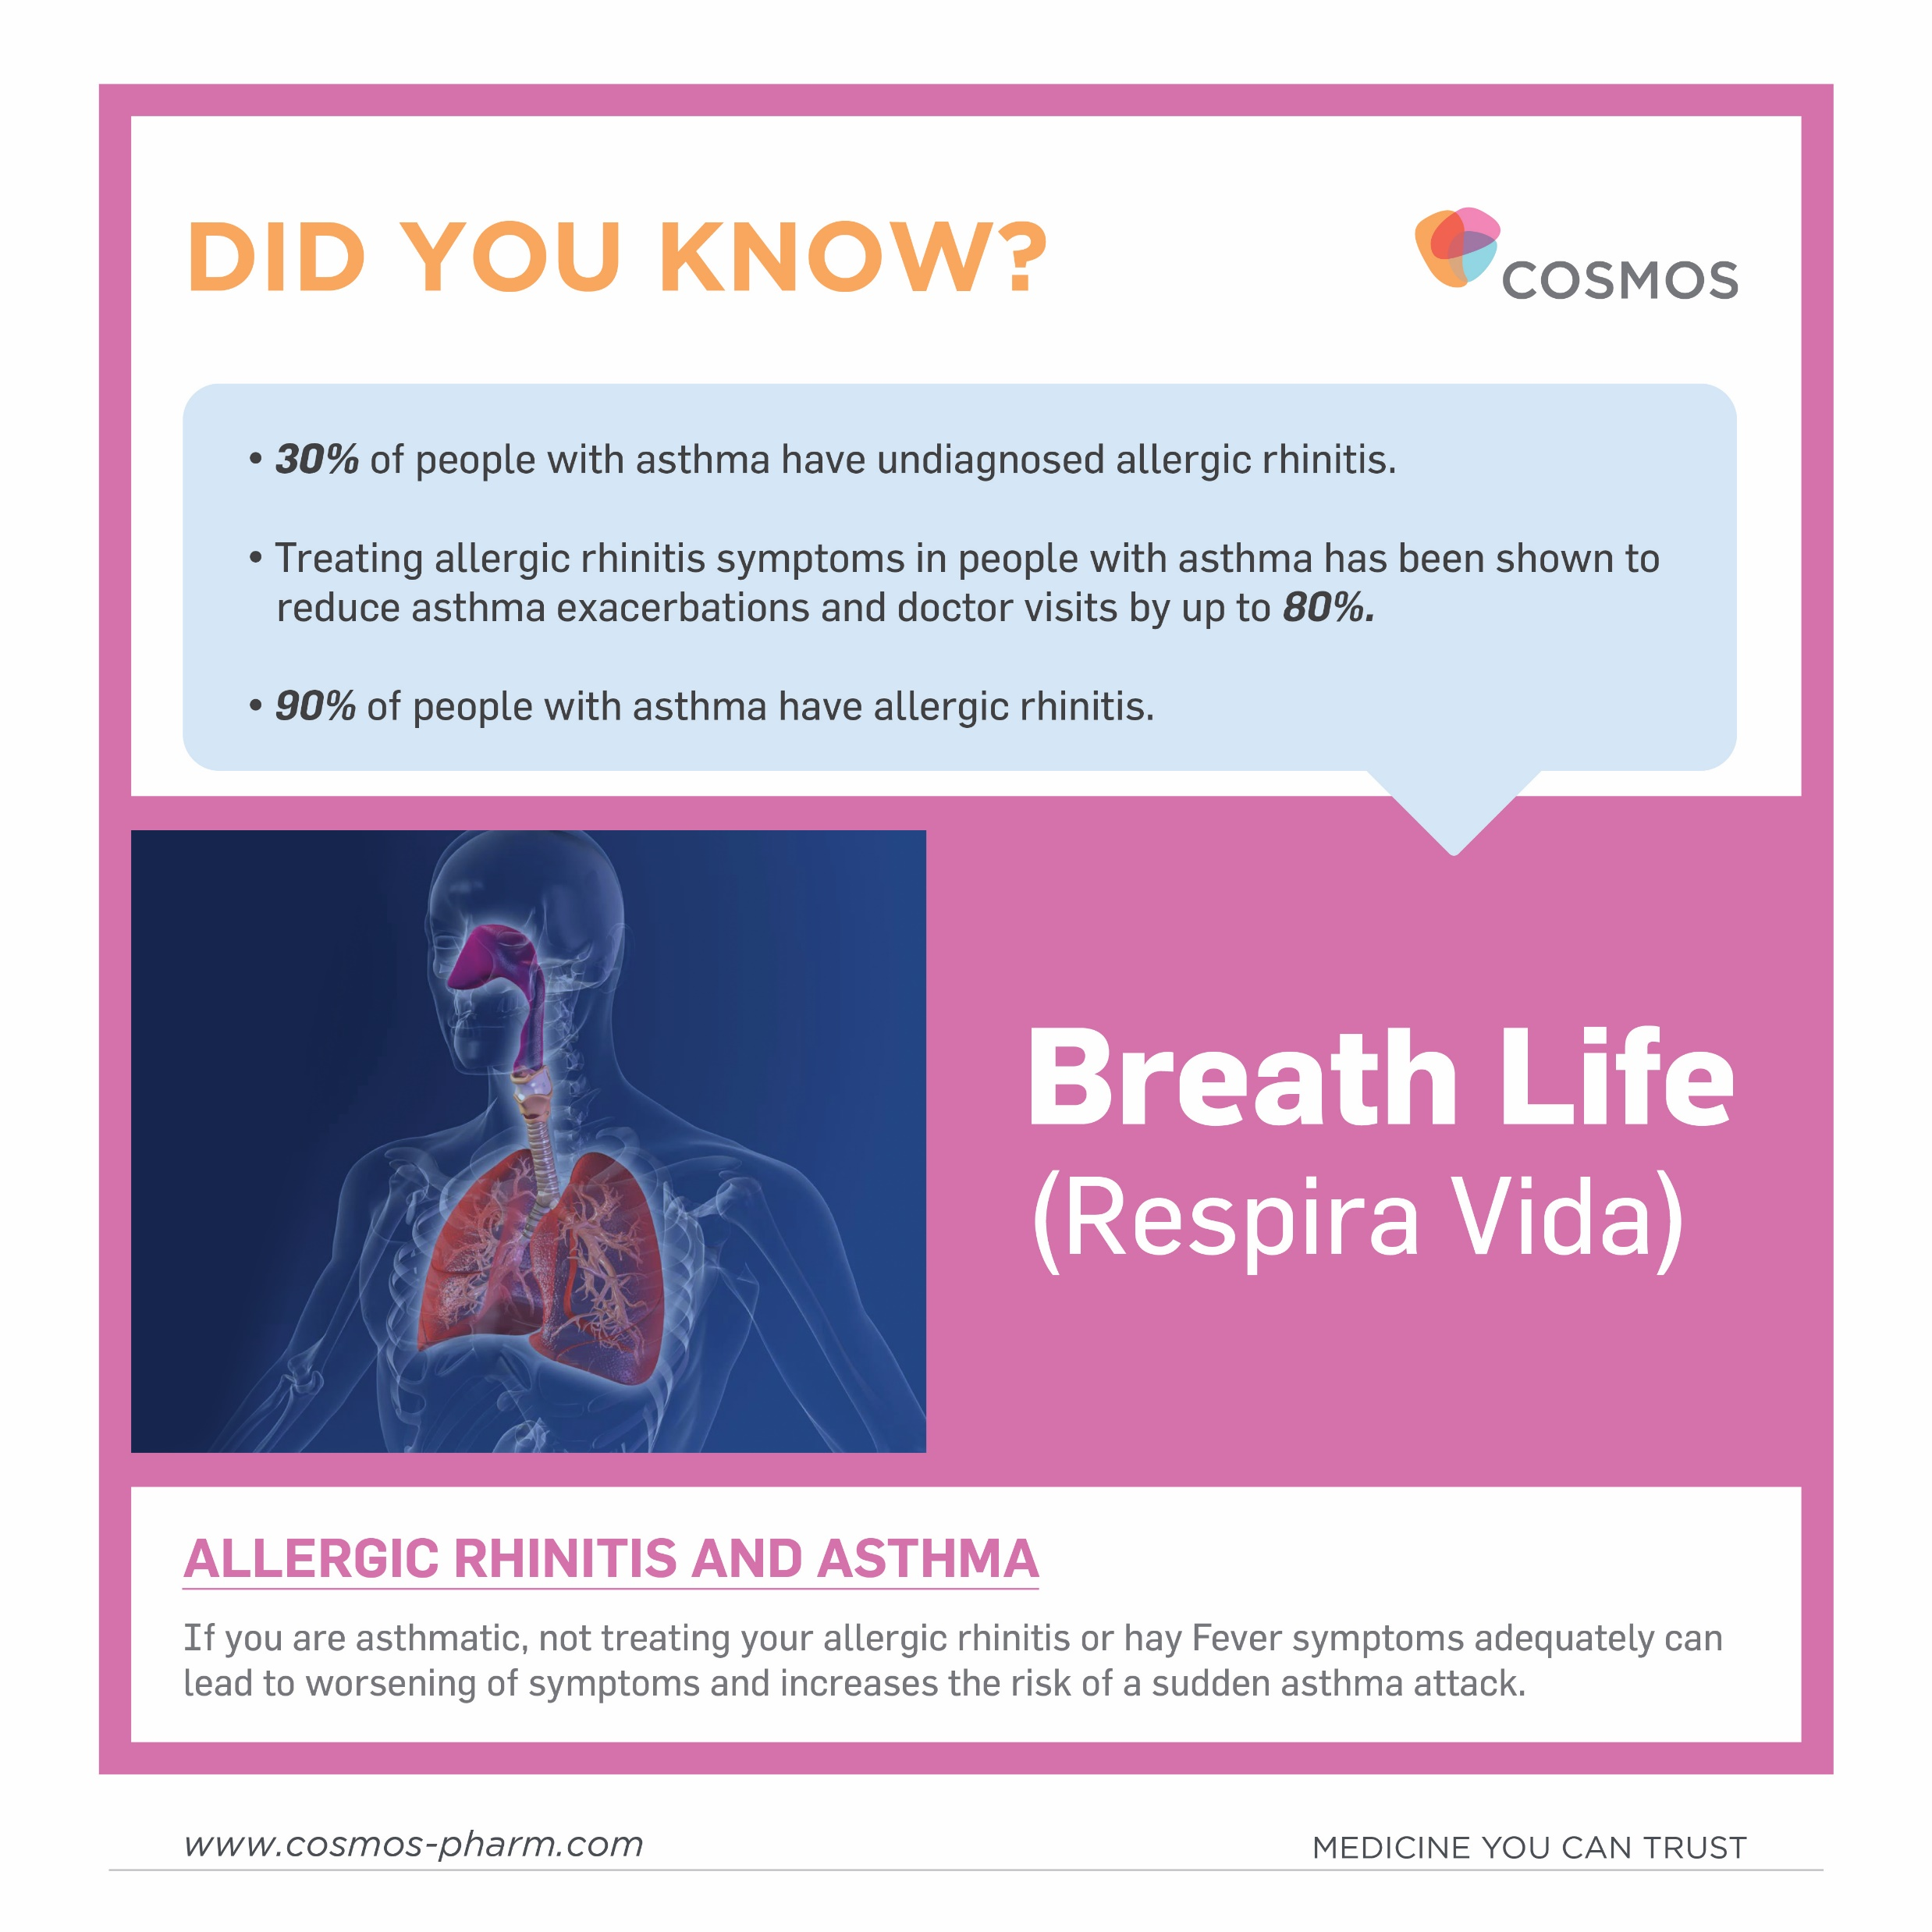

Slide 12
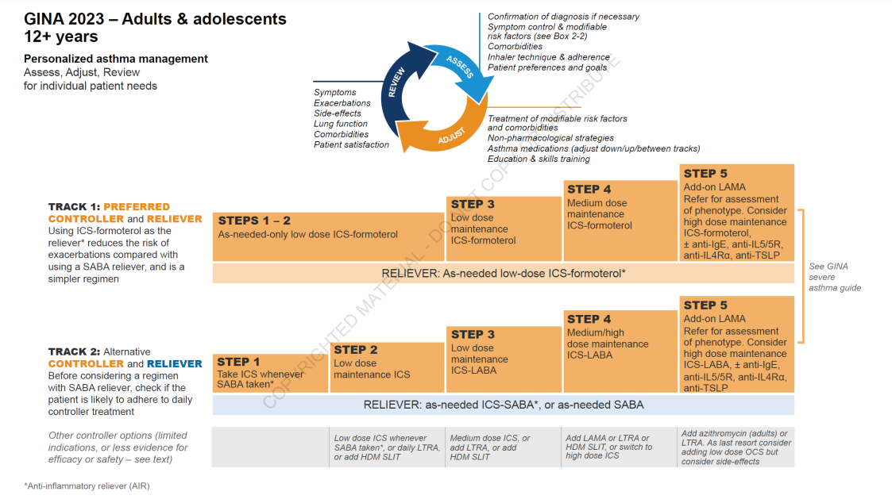
Montelukast is an LTRA and an add on controller option in management of asthma as per the GINA guidelines.

Slide 13
Montelukast in asthma management
Montelukast reduces asthma exacerbations and improves QOL.
1
2
Montelukast reduces overdependence on rescue medications.
Montelukast has anti-inflammatory effects on the airways in asthma and asthma with AR.
3

Slide 14
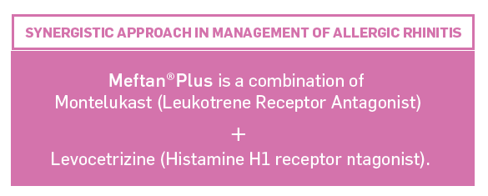
COMBINATION THERAPY IN ASTHMA WITH ALLERGIC RHINITIS Management
Meftan Plus/DT

Slide 15

Adults: 12 Years and above

Slide 16
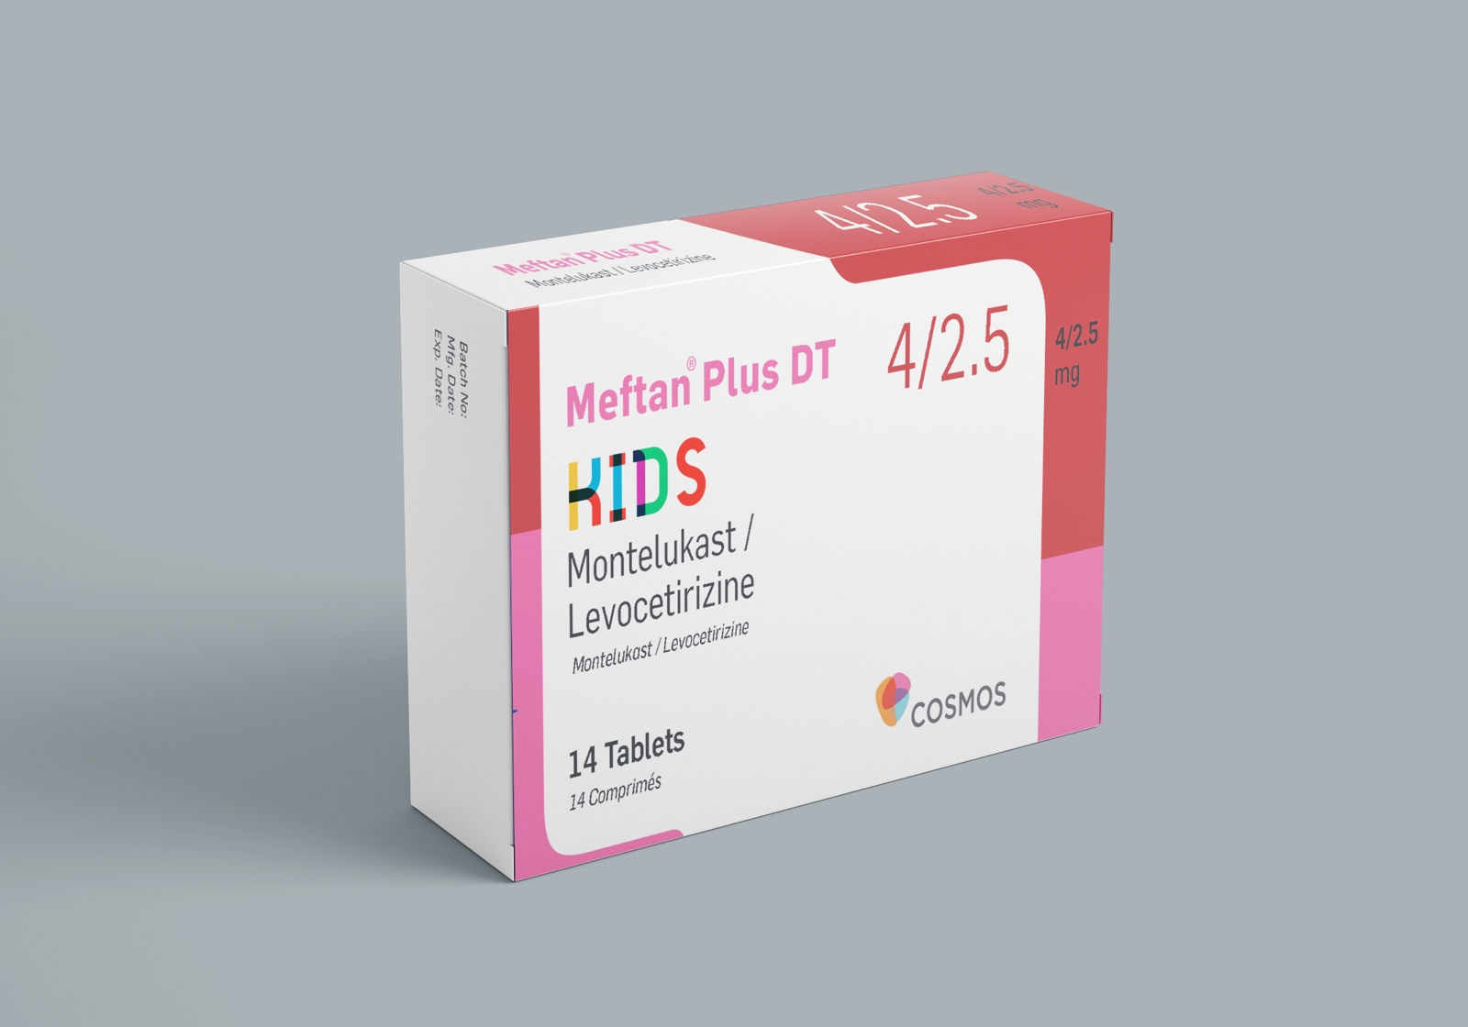


Age: 2-5 Years.
Most Affordable combination in
the market.
Synergistic symptom score
control.
Palatable Dispersible Tablets.

Slide 17
OTHER BRAND CAMPAIGNS

Slide 18


Slide 19
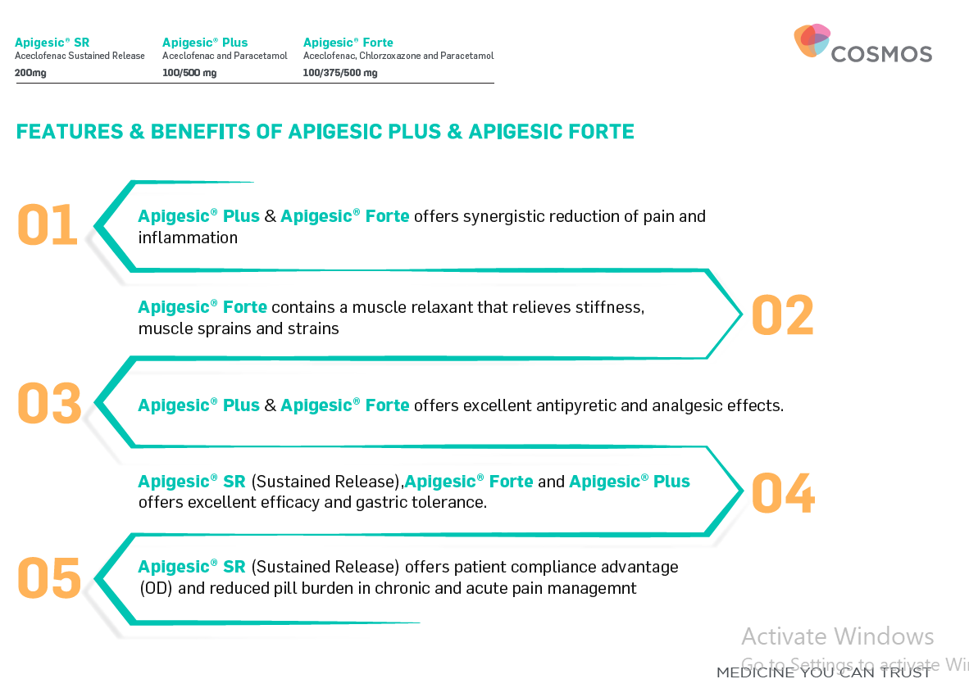

Slide 20
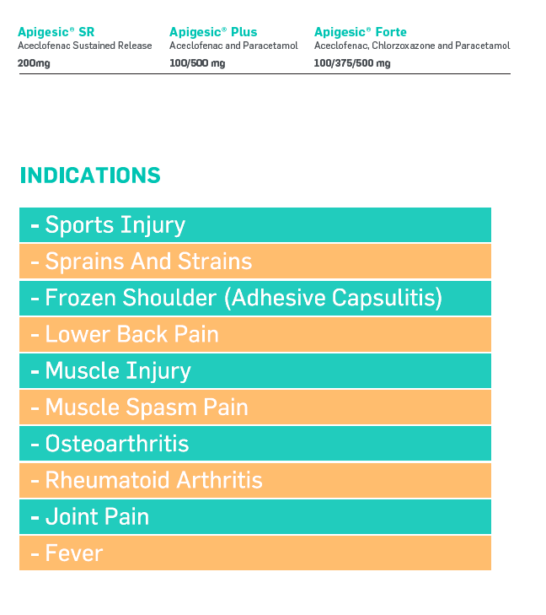


Slide 21
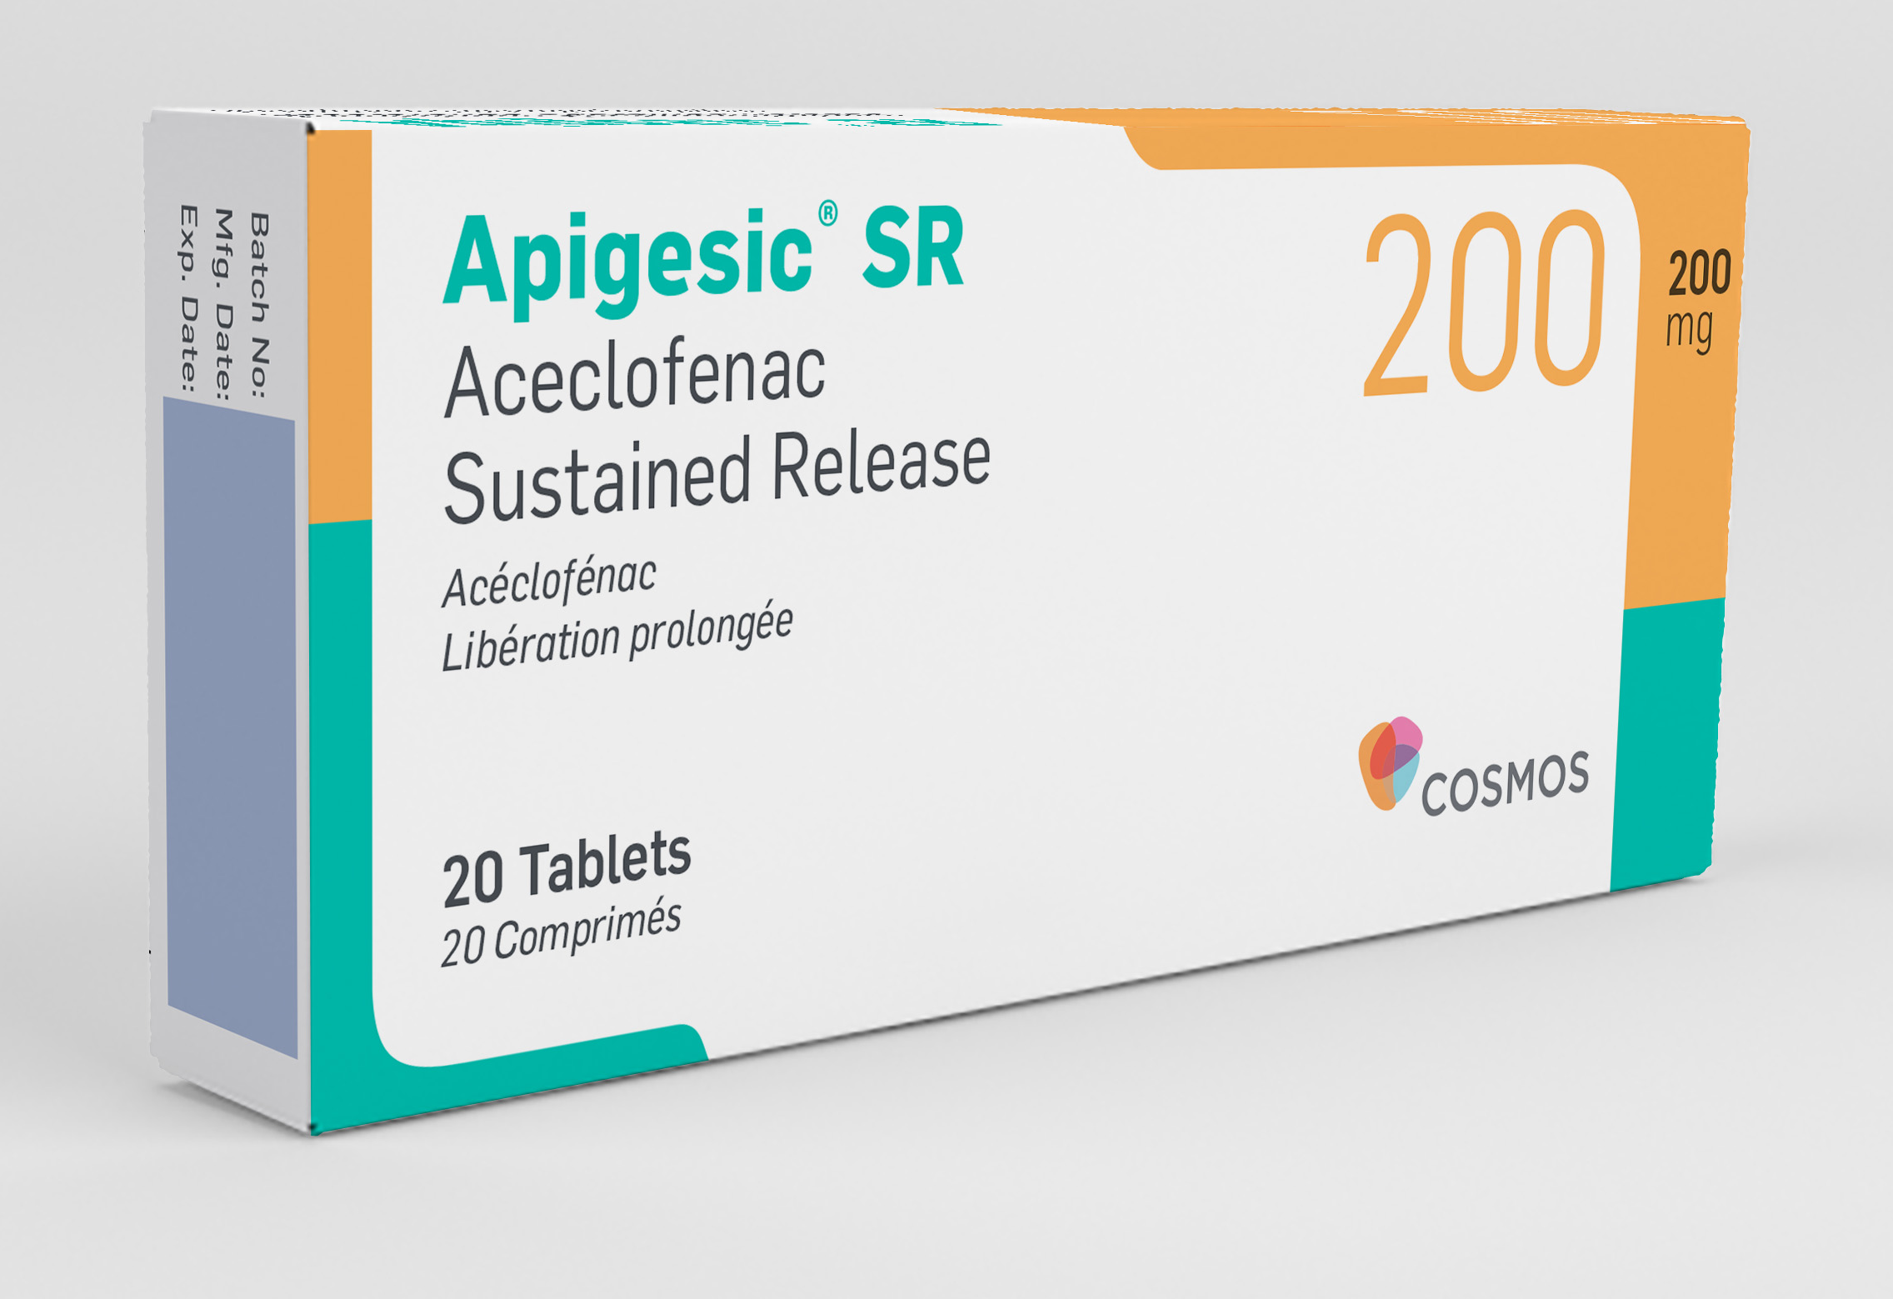
Preferential Cox 2 Inhibitor
Patient Compliance(OD) and
Reduced Pill burden
Gastric Tolerance
compared to other NSAIDs

Slide 22


Slide 23
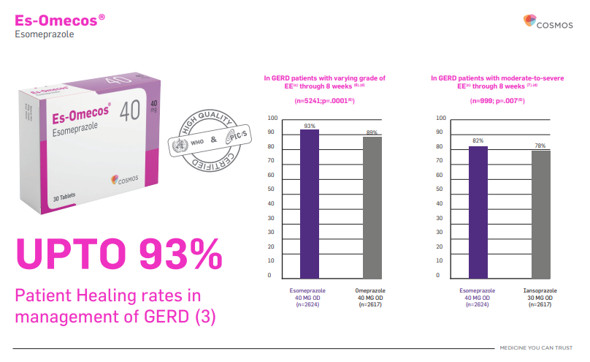

Slide 24

3D PAIN

Slide 25
Contest
KENTS 2025

Slide 26
Pharmacovigilance
Adverse Event Reporting to:
Email: drugsafety@cosmos-pharm.com
Tel: 0742 963 729

Slide 27
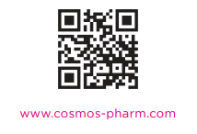
THANK YOU

