Slide 1
Laryngopharyngeal Reflux (LPR)
Understanding the 'Silent Reflux'
Presented by: Salverious Wasike
Date: 16/10/2025

Slide 2
Outline
Introduction
Body
Conclusion
controversies
References

Slide 3
Introduction to LPR
LPR, is a retrograde flow of gastric contents into the larynx and the oropharynx
LPRD- the presenting symptoms such as chronic cough, hoarseness, a lump sensation in the throat, excessive throat clearing, and a sore throat.
It's often called ''silent reflux'' because affected individuals don't experience the classic heartburn symptoms associated with gastroesophageal reflux disease (GERD).
It affects a wide range of individuals and can significantly impact their quality of life.

Slide 4
LPR vs. GERD
Feature | LPR (Silent Reflux) | GERD (Heartburn)
Primary Symptoms | Sore throat, hoarseness, chronic cough, globus sensation, throat clearing | Heartburn, chest pain, regurgitation
Reflux Location | Acid reaches the larynx and pharynx | Acid primarily affects the esophagus
Timing | Occurs during the day/upright | Occurs at night/after meals
Sphincters | Both LES & UES dysfunction | Primarily LES

Slide 5
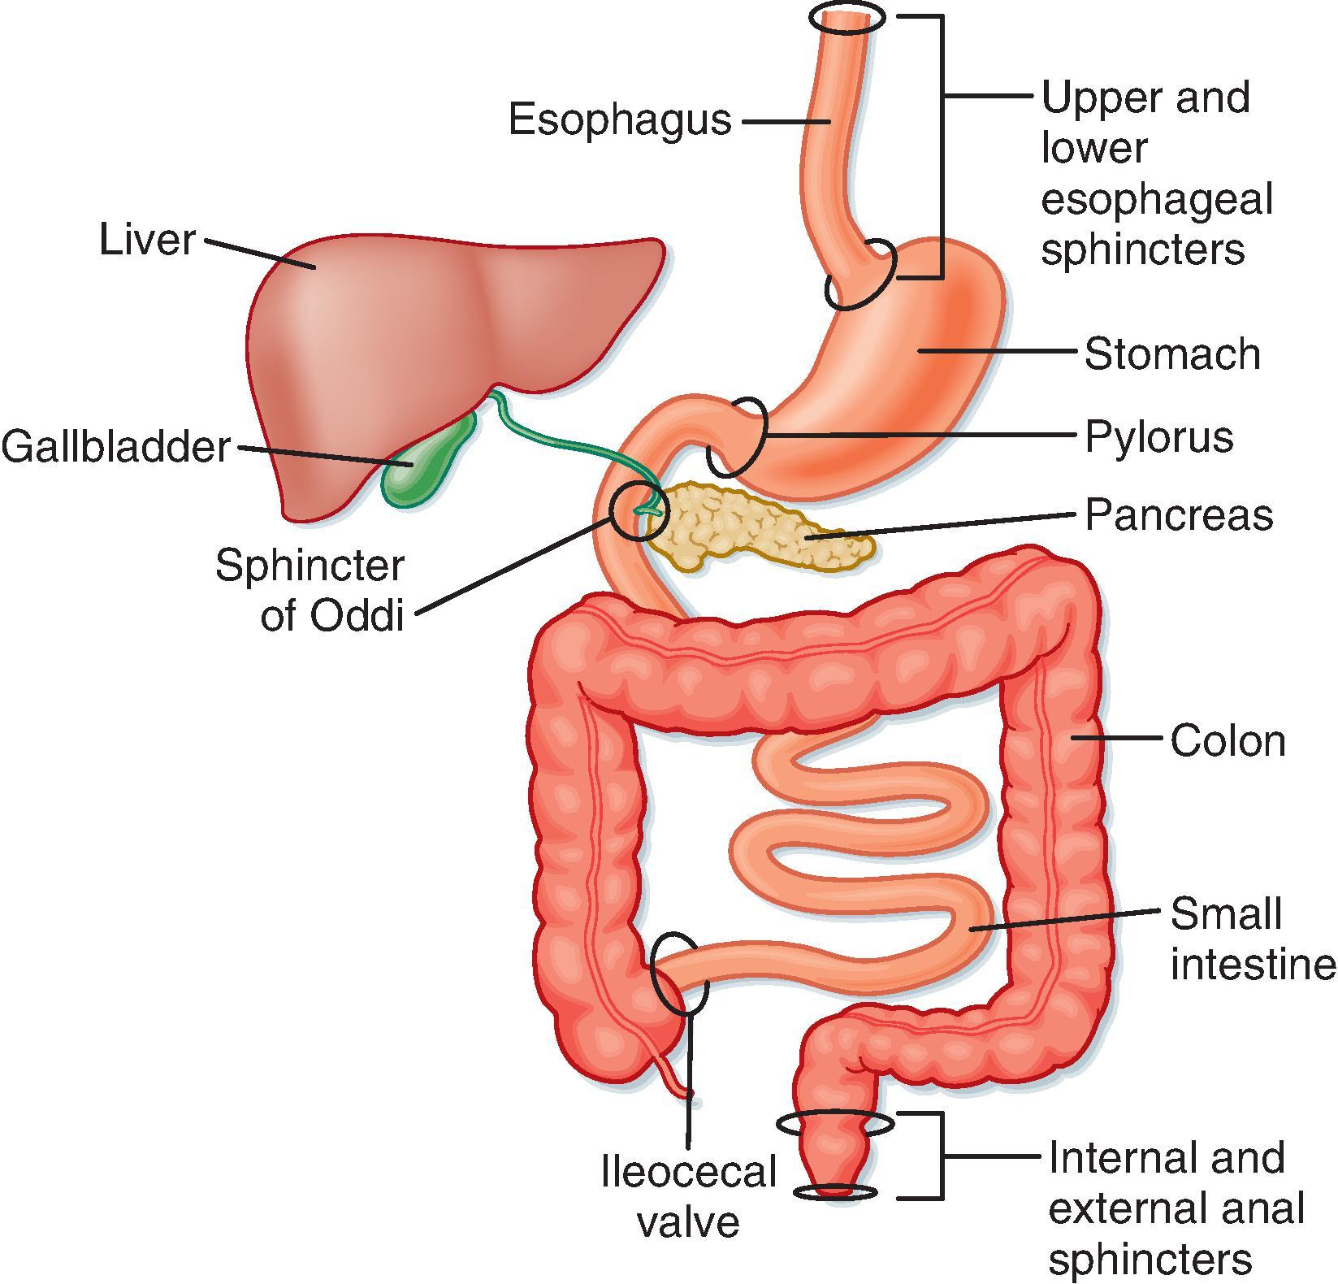
Relevant anatomy to LPR

Slide 6
Relevant Anatomical Structures
Esophagus: Muscular tube connecting pharynx to stomach.
Upper Esophageal Sphincter (UES): Prevents reflux into pharynx and larynx.
Lower Esophageal Sphincter (LES): Prevents stomach contents from refluxing.
Stomach: Digests the food with the help of acid and enzymes.

Slide 7
Relevant Anatomical Structures continuation
Larynx : Contains vocal cords; sensitive to acid.
Pharynx : Behind the mouth/nasal cavity; susceptible to reflux damage.
Damage leads to common LPR symptoms.

Slide 8
Common Symptoms of LPR
Hoarseness/Voice Changes: Due to vocal cord irritation.
Chronic Throat Clearing: Persistent need to clear throat (feeling of mucus stack in the oropharynx) .
Globus Sensation: Feeling of lump in throat.

Slide 9
Common Symptoms of LPR continuation
Chronic Cough: Persistent dry cough.
Dysphagia: Difficulty swallowing.
Sore Throat: Persistent irritation.
Post-Nasal Drip Sensation: Mucus dripping feeling.

Slide 10
Causes and Risk Factors
Sphincter dysfunction (UES & LES).
Dietary triggers: spicy foods, caffeine, chocolate, alcohol, citrus, fatty foods.
Lifestyle factors: obesity, smoking, tight clothing.
Hiatal Hernia: Stomach pushes through diaphragm.

Slide 11
Diagnosis of LPR
Patient history & symptoms.
Laryngoscopy: View larynx/pharynx-erythema, edema, posterior commissure hypertrophy
24-hour pH Monitoring: Acid exposure measurement.

Slide 12
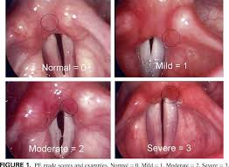
Laryngoscopy findings

Slide 13
Treatment & Management
Dietary & Lifestyle modifications:
- Avoid late meals
- Avoid trigger foods/drinks
- Eat small frequent meals
- Don't lie down immediately after meals
- Elevate head of bed
- Lose weight- obese cases
- Quit smoking & limit alcohol

Slide 14
Treatment & Management
Medications:
- Proton Pump Inhibitors (PPIs)
- H2 Blockers-ranitidine, famotidine,cimeditine
- Antacids
Alginate therapy-derived from sea weed that forms a gel raft protective layer in the GIT
Surgery: Fundoplication in severe cases.

Slide 15
Potential Complications
Vocal Cord Damage: Nodules, polyps, granulomas.
Subglottic Stenosis: Narrowing below vocal cords.
Increased Risk: Laryngeal cancer.
Respiratory: Asthma, bronchitis.

Slide 16
Conclusion
LPR is common but misdiagnosed.
Different from GERD.
Management: lifestyle + medication.
Early diagnosis prevents complications.

Slide 17
Controversies for LPR
There is no standardized diagnostic criteria,
There is a debate over the effectiveness and optimal use of reflux monitoring and treatment with proton pump inhibitors (PPIs)
There is difficulties in attributing symptoms to LPR due to non-specific findings
There are questions about its role in other respiratory and sinus issues

Slide 18
Q&A
Questions?
Thank you!

Slide 19
References
Koufman JA (2002). Otolaryngologic Manifestations of GERD. Laryngoscope.
Belafsky PC, Postma GN, Koufman JA (2001). Reflux Symptom Index. J Voice.
NIDDK (2022). GER & GERD in Adults. www.niddk.nih.gov
AAO-HNS (2022). Laryngopharyngeal Reflux. www.entnet.org

