Slide 1


A DIAGNOSTIC DILEMMA & A DELIGHT IN ENT PRACTICE
BY
MAINA MACHARIA
RCO/ENT-KCH

Slide 2
OUTLINE
Abbreviations and their meanings
Abstract
Introduction
Case report
Discussion
Learning points/conclusion
Acknowledgement
References

Slide 3


ABREVIATIONS AND THEIR MEANINGS
ENT-EAR,NOSE AND THROAT
KNH-KENYATTA NATIONAL HOSPITAL
KCH-KERUGOYA COUNTY HOSPITAL
PCP- PRIMARY CARE PRACTITIONERS
O/E-ON EXAMINATION
L/E- LOCAL EXAMINATION

Slide 4
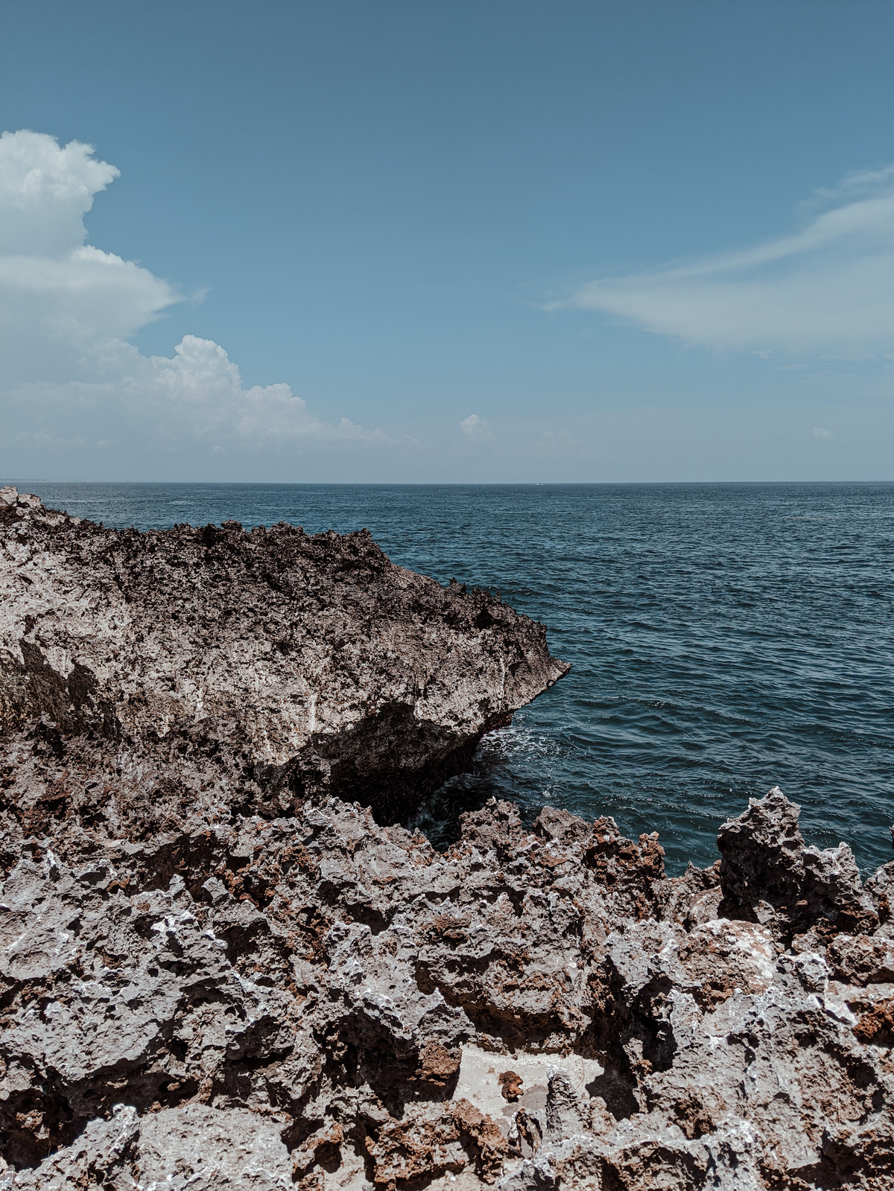
ABSTRACT
ENT conditions are mostly straight forward
In some cases , symptoms overlap, signs are associated.[8]
Investigations may fail to accurately diagnose.[7]
In this case, a mother, the informant, noted T.N.M.-2&1/2yrs develop chock, cough and noisy breathing.
Prior to the above, he was eating macadamia while playing with other children.

Slide 5
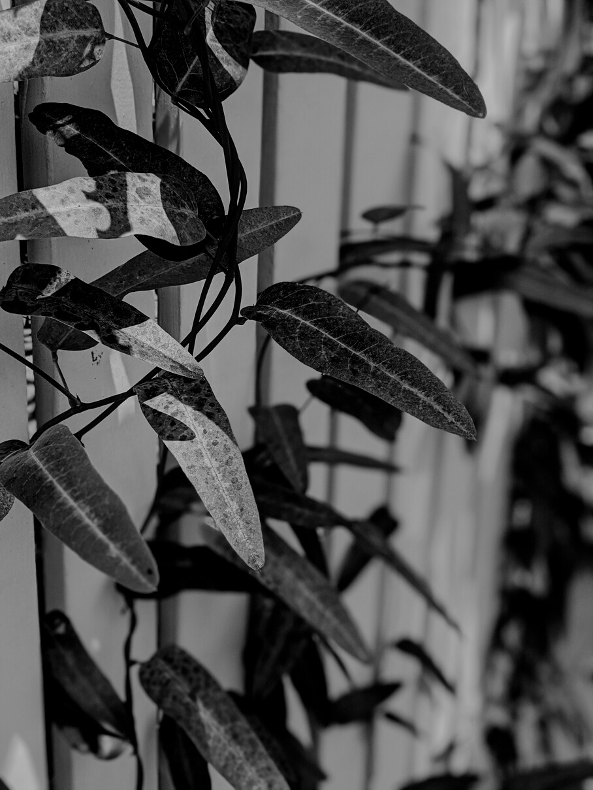
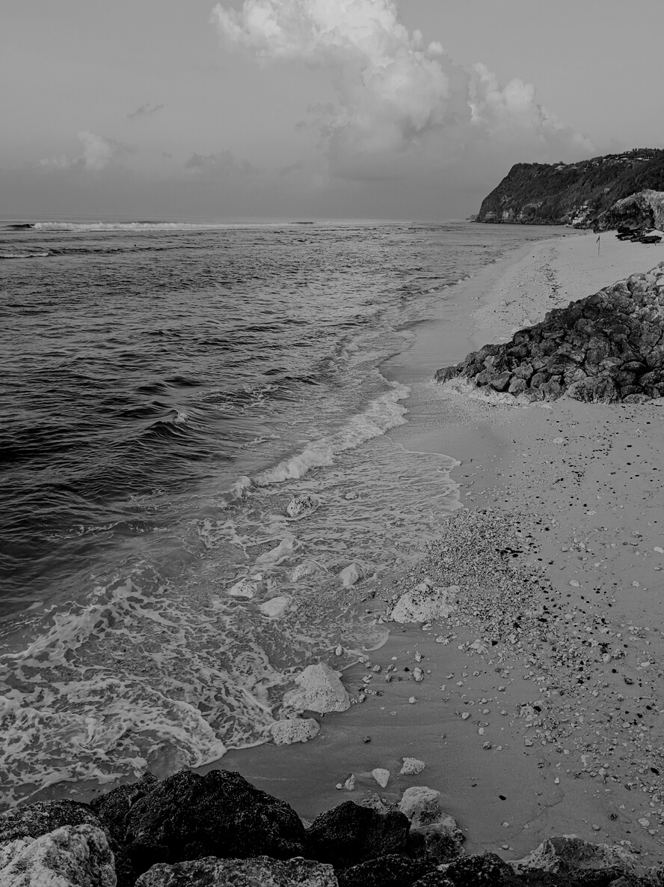
ABSTRACT
She visited KCH 3/7 later.
Admitted as aspiration pneumonia
X-ray had nothing abnormal reported,
Nebulized with ventollin for 11/7.
Discharged through ENT.
Chest In drawing noted in ENT.
Referred to KNH as an emergency of inhaled foreign body.

Slide 6
ABSTRACT
X-ray at KNH non revealing
CT scan chest –nothing abnormal detected.
MRI chest- No remarkable finding.
Nebulized for wheezing for 2/7.
No improvement, discharge contemplated.
Mother declined, insisted on something amiss.
Bronchoscopy done 2/7 days later.

Slide 7
ABSTRACT
4 pieces of macadamia removed from right bronchus.
suppuration changes noted on their lodgment sites.
Suctioning done. Patient’s condition deteriorated.
Resuscitation done, discharged to the ICU.

Slide 8
ABSTRACT
2/7 later improved, discharged to the ward.
Fully discharged after a further 2/7 in the ward.
Had been on antibiotics in the ward.
Conclusions included the need for a dedicated history , thorough physical examination and
Need to apply Jackson’s dictum since investigations have failure rates.

Slide 9
Jackson’s dictum
In suspected cases of FBs in the air passages ,bronchoscopy must be done as failure to do bronchoscopy is more disastrous than the complications of bronchoscopy.[1]

Slide 10
INTRODUCTION
Dilemmas in making an ENT diagnosis exist.
This is due to:
Overlapping of symptoms
Variations in disease presentation
Complexity of ENT related pathologies
This leads to:
Diagnostic errors
Inappropriate referrals

Slide 11
INTRODUCTION
Diagnosis is based on proper history , clinical examination and relevant examination.[7]
Indeed, it is very uncommon to come across cases where neither history favors, nor the presentation of disease entity is so modified that management becomes challenging.[7]
Most of the time such cases are either overlooked or mismanaged.[7]

Slide 12
INTRODUCTION
A case in point is Foreign bodies in tracheobronchial system.
They pose a life threatening situation.[9]
Radiopaque foreign bodies are easily detected on Chest x-rays.[9]
But most inhaled foreign bodies are radiolucent and frequently of food origin.[9]
Their symptoms overlap with diseases such as:

Slide 13
INTRODUCTION
pneumonia,
croup,
or asthma
This may challenge clinicians on whether to perform a bronchoscopy or not.[9]
Where the event is not witnessed , symptoms are vague and can lead to:
Delayed diagnosis
Increased incidences of complications
Sometimes fatal outcomes.[7]

Slide 14
INTRODUCTION
Radiolucent FBs account for80-90% of inhaled FBs[6]
Witnessed account for 50%.[6]
Radiography accuracy includes:
X-rays -24% normal , whereas bronchoscopy demonstrates presence.[6]
Laryngeal/tracheal FBs-58% X-rays read normal.
CT Scan-3D=94% accurate.[6]

Slide 15
INTRODUCTION
Utrasound-provides 90% accuracy.[6]
MRI- relies on “susceptibility artifact”= distortion of magnetic field. Unreliable for most FBs.[6]
Initial responders hold very low index of suspicion.[7]
T.N.M’S condition escaped capture by history, physical findings, and all the investigation modalities conducted on him.

Slide 16
CASE REPORT
T.N.M. was brought to KCH ON 7/11/24.
P/C
Fast breathing-3/7
Wheezing-3/7
Mother gave a hx of eating macadamia then-chock-cough-wheeze.
Had a positive hx of a brother with bronchospasms

Slide 17
CASE REPORT
O/E
Fgc no cyanosis, no dehydration
R/S
Rhonci+
Imp: aspiration pneumonia
X-ray-nothing abnormal detected.
Admit
Nebulisation with ventollin,x-pen,Gentamicin.

Slide 18

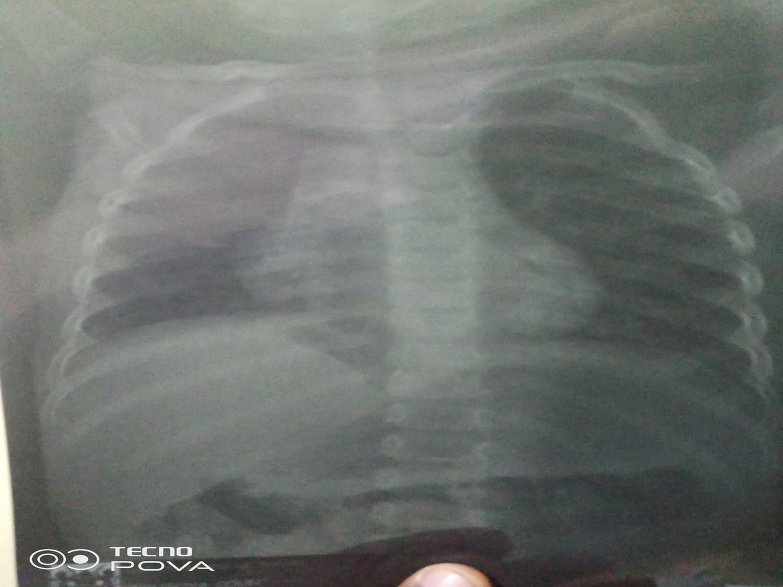

Slide 19
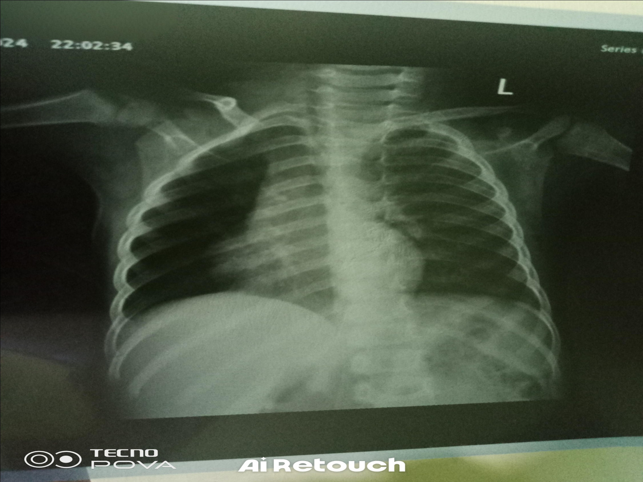

Slide 20
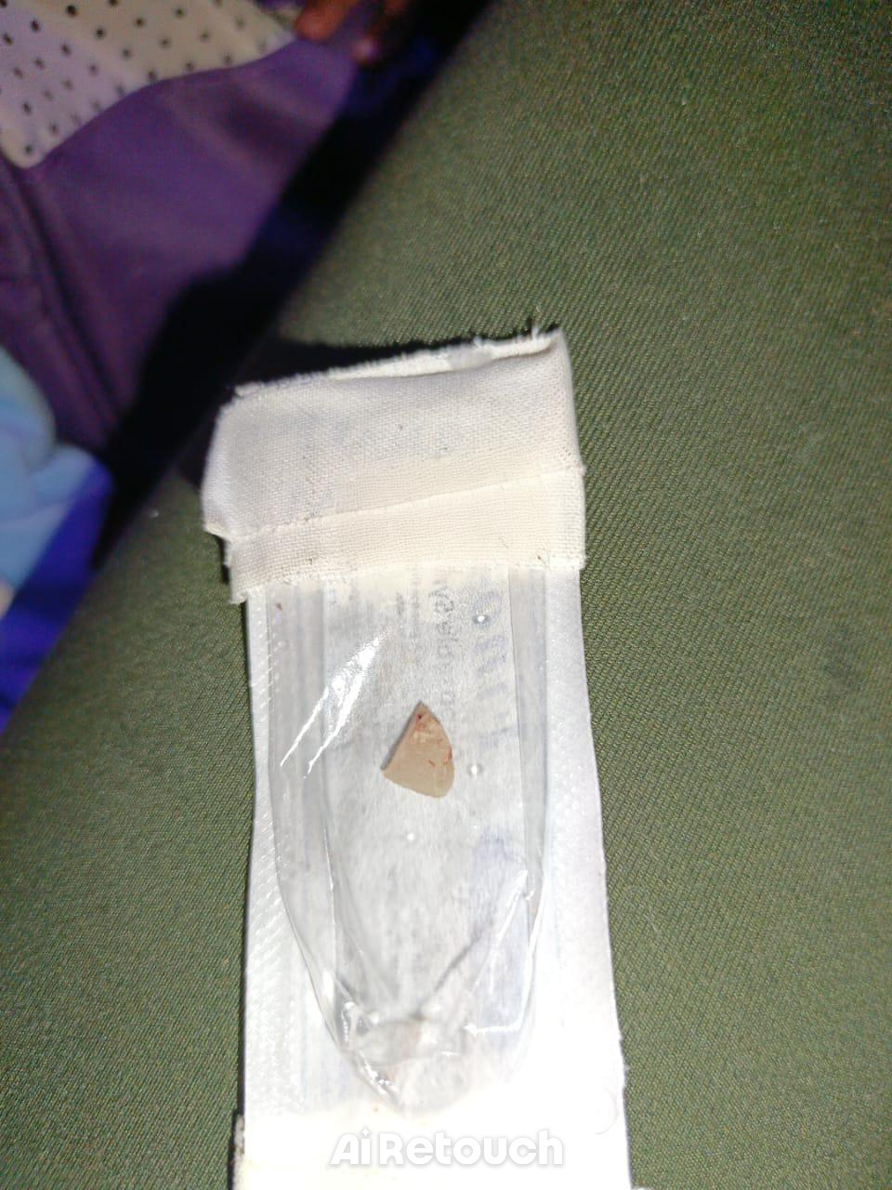

Slide 21
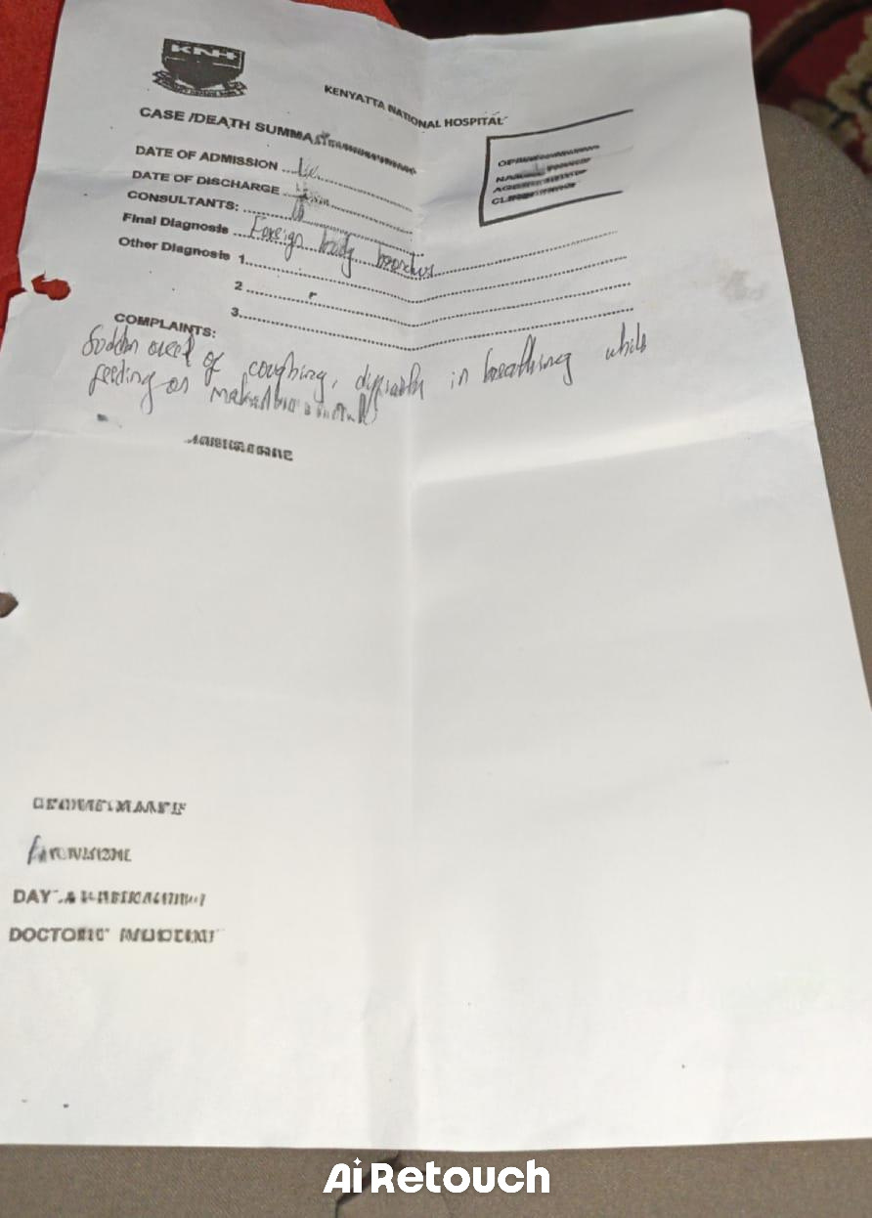

Slide 22
DISCUSSION
The informant gave a history of T.N.M inhaling a foreign body prior to the set of events.
The clear pattern of Chock-cough-wheeze was evident.[5]
Physical examination revealed rhonci on examination
A diagnosis of aspiration pneumonia was made.

Slide 23
DISCUSSION
An x-ray chest done had nothing abnormal detected.
Treatment by nebulization commenced.
By definition , aspiration is where there are inhaled liquids or food,[5]
By contrast, inhaled foreign body is when a physical object is breathed into the lungs.[5]
There is a thin line between these diagnoses.

Slide 24
DISCUSSION
This was a witnessed event, as the mother had a clear recollection of the events.
Mother’s history is crucial in pediatric practice.[10]
It provides the context for symptoms , informing treatment decisions and guiding preventive care.[10]
70% of pediatric diagnosis comes from history[10].

Slide 25
DISCUSSION
A great reliance is placed on the mother’s history.[10]
Physical examination helps to narrow the differential diagnosis.[10]
It helps to improve diagnosis from 70% to 90%[10]
It is cost effective.[10]
X-ray as a modality for investigations where radiolucent inhaled FBs is involved:

Slide 26
DISCUSSION
Need to be requested with the effect of Fb on lung function in mind.[5]
Needs the radiographer to capture inhalation phase to demonstrate lung inflation due to “ball valve effect”[5]
Needs to be interpreted on the effect of FB rather than FB itself.[5]
Its failure rate of 24% needs to be borne in our mind,[6]

Slide 27
DISCUSSION
CT scan-needs 3D as a proper ordering.
It is 91% effective.[6]
MRI-Needs a T1 weighted image. It cannot detect the” artifact” of a foreign body that has no magnetic field like a macadamia cotyledon.[6]
Jackson’s dictum on the role of bronchoscopy in inhaled FB is useful.[1]

Slide 28
LEARNING POINTS/CONCLUSION
There is need to:
Be aware about the crucial nature of mother’s history/any medical history.
Need to be aware of specific disease patterns during presentation.( a doctor only sees what he/she knows)
Be aware that investigations have their own failure rates.

Slide 29
LEARNING POINTS
Importance of holding a high index of suspicion in an emergency situation.-ability to make quick and solid decisions.
Communicate and share feedback with colleagues to increase competence in medical/surgical practice.
Radiographic findings do not rule out the presence of a foreign body.[5]

Slide 30
LEARNING POINTS
Bronchoscopy should be performed on children in whom a chocking event has been witnessed even in cases of normal radiological and clinical findings.[9]

Slide 31
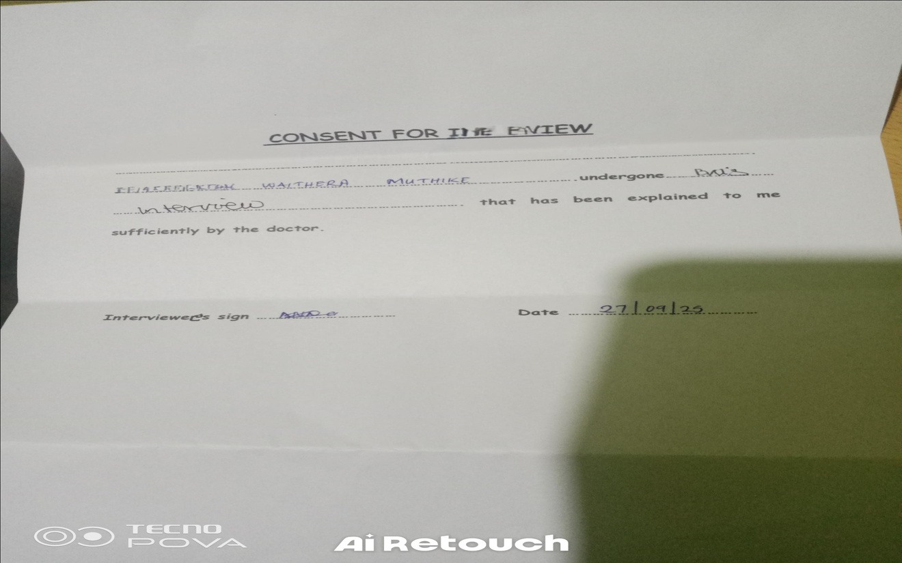
CONSENT

Slide 32
ACKNOWLEGDEMENTS
This study was supported by Dr. S.Warui,head and neck surgeon Nyeri level V hospital,Nyeri county,for whom I am forever grateful,Mr. Ahmednasir H. Who mentored me through out the study and Mr. Mose a practicing ENT clinician at KNH for burning the midnight oil to make it a success.

Slide 33
DECLARATION
There is no conflict of interest

Slide 34
REFERENCES
1. Diseases of Ear,Nose&Throat by Mohan Bansal 1ˢᵗ edition 2013,New Delhi,India.
2.Textbook of Ear,Nose and Throat diseases by Mohammed M et al 11ᵗʰ edition,2007,New Delhi,India.
3. Otorhinolaryngology,Head and Neck surgery by Anniko et al ,1ˢᵗ edition 2010 Berlin Heidelberg,Germany.
4.Diseases of Ear,nose and Throat by Logan T,11ᵗʰ edition,2016, Chicago,USA.
5.Cummings Otolaryngology by Phelps et al,5ᵗʰ editionPhiladelphia,2010,USA.
6.Imaging Foreign Bodies:ingested,Aspirated and inserted.Annals of emergency medicine 66(6) : 570-582.e5. by Tseng et alnDecember2015.

Slide 35
REFERENCES
7. Updates on Foreign Body in ENT practice edited by Balwant SG. Article “current approach to Diagnosis and Treatment of Foreign Body in Otorhinolaryngology” submitted:24 of January 2024 by Dusan M et al.
8.Abdul et al DIFFICULT & CHALLENGING FOREIGN BODIES IN ENT PRACTICE, journal of Bacha Khan Medical College 1(02) Page No. 41-46. https;//doi.org/10.69830/jbkmc.v1i02.68

Slide 36
REFERENCES
9.https://doi.org/10.1016/j.pedneo.2016.07.003 A dilemma for the pediatrician: Radiolucent Tracheobroncial Foreign Body
10.https://www.jaypeedigital.com-Rationale of the pediatric history-Salient features.

Slide 37
Thank You

